Slide 1
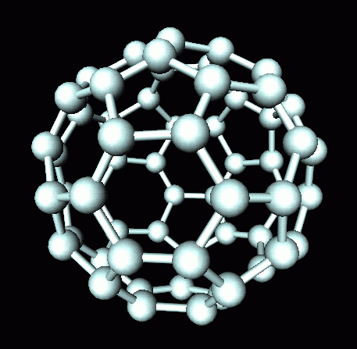
02/06/2020
Key Concepts in Chemistry
EdExcel 2016 Chemistry topic 1
W Richards
Education Using PowerPoint

Slide 2
Atomic Structure

Slide 3
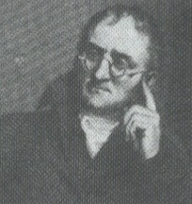
The structure of the atom
I first came up with the idea of the atom (after the Ancient Greeks). Our understanding of what it looks like has changed over time due to discoveries of subatomic particles:
Dalton
ELECTRON – negative, mass nearly nothing
NEUTRON – neutral, same mass as proton (“1”)
PROTON – positive, same mass as neutron (“1”)

Slide 4
The structure of the atom
Particle | Relative Mass | Relative Charge
Proton | 1 | +1
Neutron | 1 | 0
Electron | 1/2000 (i.e. 0) | -1
MASS NUMBER = number of protons + number of neutrons
4
He
SYMBOL
ATOMIC NUMBER = number of protons. All atoms of a particular element must have the same number of protons.
2

Slide 5
Mass and atomic number
How many protons, neutrons and electrons?
1
11
16
H
B
O
1
5
8
23
35
238
Na
Cl
U
11
17
92

Slide 6
The structure of the atom in more detail
The nucleus is around 10,000 times smaller then the atom! The diameter of the nucleus is around 10⁻¹⁴m.
ELECTRON – negative, mass nearly nothing
The nucleus – this contains most of the mass in an atom
PROTON – positive, same mass as neutron (“1”)
NEUTRON – neutral, same mass as proton (“1”)
Atoms always have the same number of protons and electrons so they are neutral overall. The atom is around 0.1nm big (i.e. 10-10m).

Slide 7
Isotopes
02/06/2020
An isotope is an atom with a different number of neutrons:
Notice that the mass number is different. How many neutrons does each isotope have?
16
17
18
O
O
O
8
8
8
Each isotope has 8 protons – if it didn’t then it just wouldn’t be oxygen any more.

Slide 8
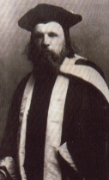
Strange atomic masses
When you look at a periodic table sometimes the atomic mass is not a whole number. Consider chlorine, for example:
How can an atom have a decimal for its mass?
35.5
This is because out of every four naturally occurring chlorine atoms, 3 have a mass of 35 and 1 has a mass of 37 so the average atomic mass is:
Cl
17
(3 x 35 + 1 x 37) / 4 = 35.5
Q. Magnesium is often found as ²⁴Mg or ²⁶Mg. If 79% of magnesium is ²⁴Mg what is the average atomic mass?
(79 x 24 + 21 x 26) / 100 = 24.4

Slide 9
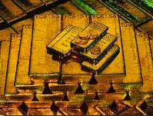
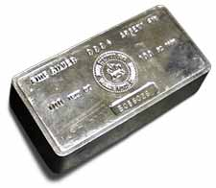
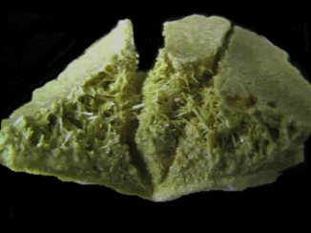
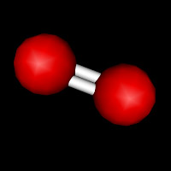
Periodic Table Introduction
How would you arrange these elements into groups?

Slide 10

Periodic table
02/06/2020
The periodic table arranges all the elements in groups according to their properties.
Vertical columns are called GROUPS
Mendeleev
Horizontal rows are called PERIODS

Slide 11
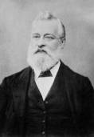
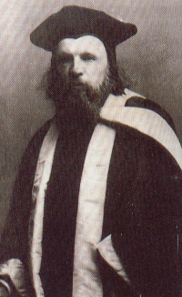
Development of the Periodic Table
1864: John Newlands arranged the known elements in order of atomic mass and found out that every 8th element had similar properties:
Li | Be | B | C | N | O | F | Na | Mg | Al
1869: Dimitri Mendeleev arranged the known elements in order of mass but he also left in gaps and was able to predict the properties of unknown elements:
Li | Be | B | C | N | O | F |  | Na | Mg | Al
When I came up with my Periodic Table I thought that I had arranged elements in order of atomic mass. However, I was wrong because I did not take into account the masses of different isotopes.

Slide 12
The Periodic Table
Fact 1: Elements in the periodic table are arranged in order of proton number:
 |  |  |  |  | H |  |  |  |  |  |  |  |  |  |  |  | He
Li | Be |  |  |  |  |  |  |  |  |  |  | B | C | N | O | F | Ne
Na | Mg |  |  |  |  |  |  |  |  |  |  | Al | Si | P | S | Cl | Ar
K | Ca |  |  |  |  |  | Fe |  | Ni | Cu | Zn |  |  |  |  | Br | Kr
 |  |  |  |  |  |  |  |  |  | Ag |  |  |  |  |  | I | Xe
 |  |  |  |  |  |  |  |  | Pt | Au | Hg
E.g. Lithium has 3 protons while Beryllium has 4

Slide 13

The Periodic Table
Fact 2: Most of the elements are metals:
These elements are metals – they form “positive ions”
 |  |  |  |  | H |  |  |  |  |  |  |  |  |  |  |  | He
Li | Be |  |  |  |  |  |  |  |  |  |  | B | C | N | O | F | Ne
Na | Mg |  |  |  |  |  |  |  |  |  |  | Al | Si | P | S | Cl | Ar
K | Ca |  |  |  |  |  | Fe |  | Ni | Cu | Zn |  |  |  |  | Br | Kr
 |  |  |  |  |  |  |  |  |  | Ag |  |  |  |  |  | I | Xe
 |  |  |  |  |  |  |  |  | Pt | Au | Hg
These elements are non-metals – they form “negative ions”
This line divides metals from non-metals

Slide 14
Electron structure
Consider an atom of Potassium:
39
K
19
Nucleus
Potassium has 19 electrons. These electrons occupy specific energy levels “shells”…
The inner shell has __ electrons
The next shell has __ electrons
The next shell has __ electrons
The next shell has the remaining __ electron
Electron structure
= 2,8,8,1

Slide 15
Electron structure
Draw the electronic structure of the following atoms:
14
24
40
N
Mg
Ca
7
12
20
Nucleus
Nucleus
Nucleus
Electron structure
= 2,5
Electron structure
= 2,8,2
Electron structure
= 2,8,8,2

Slide 16
The Periodic Table
Fact 3: Elements in the same group have the same number of electrons in the outer shell (this corresponds to their group number)
 |  |  |  |  | H |  |  |  |  |  |  |  |  |  |  |  | He
Li | Be |  |  |  |  |  |  |  |  |  |  | B | C | N | O | F | Ne
Na | Mg |  |  |  |  |  |  |  |  |  |  | Al | Si | P | S | Cl | Ar
K | Ca |  |  |  |  |  | Fe |  | Ni | Cu | Zn |  |  |  |  | Br | Kr
 |  |  |  |  |  |  |  |  |  | Ag |  |  |  |  |  | I | Xe
 |  |  |  |  |  |  |  |  | Pt | Au | Hg
E.g. all group 1 metals have __ electron in their outer shell
These elements have __ electrons in their outer shells
These elements have __ electrons in their outer shell

Slide 17
The Periodic Table
Fact 4: As you move down through the periods an extra electron shell is added:
E.g. Lithium has 3 electron in the configuration 2,1
 |  |  |  |  | H |  |  |  |  |  |  |  |  |  |  |  | He
Li | Be |  |  |  |  |  |  |  |  |  |  | B | C | N | O | F | Ne
Na | Mg |  |  |  |  |  |  |  |  |  |  | Al | Si | P | S | Cl | Ar
K | Ca |  |  |  |  |  | Fe |  | Ni | Cu | Zn |  |  |  |  | Br | Kr
 |  |  |  |  |  |  |  |  |  | Ag |  |  |  |  |  | I | Xe
 |  |  |  |  |  |  |  |  | Pt | Au | Hg
Sodium has 11 electrons in the configuration 2,8,1
Potassium has 19 electrons in the configuration __,__,__,__

Slide 18
Ionic Bonding

Slide 19
Compounds
Methane
Sodium chloride (salt)
Compounds are formed when two or more elements are chemically combined. Some examples:
Glucose
How are these compounds formed? Let’s consider two ways – “ionic” and “covalent” bonding.

Slide 20
Introduction to Bonding
Cl
Hi. My name’s Johnny Chlorine. I’m in Group 7, so I have 7 electrons in my outer shell
I’d quite like to have a full outer shell. To do this I need to GAIN an electron. Who can help me?
Cl

Slide 21
Ionic Bonding
Cl
Here comes a friend, Sophie Sodium
Na
Hey Johnny. I’m in Group 1 so I have one electron in my outer shell. I don’t like only having one electron there so I’m quite happy to get rid of it. Do you want it?
Okay
-
+
Cl
Na
Now we’ve both got full outer shells and we’ve both gained a charge which attracts us together. We’ve formed an IONIC bond.

Slide 22
Ions
An ion is formed when an atom gains or loses electrons and becomes charged:
-
The electron is negatively charged
+
The proton is positively charged
+
If we “take away” the electron we’re left with just a positive charge:
+
This is called an ion (in this case, a positive hydrogen ion, also called a cation).

Slide 23
Ionic bonding
This is where a metal bonds with a non-metal (usually). Instead of sharing the electrons one of the atoms “_____” one or more electrons to the other. For example, consider sodium and chlorine:
Sodium has 1 electron on its outer shell and chlorine has 7, so if sodium gives its electron to chlorine they both have a ___ outer shell and are ______.
Na
Cl
+
-
A _______ charged sodium ion (cation)
A _________ charged chloride ion (______)
Na
Cl
Group 1 _______ will always form ions with a charge of +1 when they react with group 7 elements. The group 7 element will always form a negative ion with charge -1.
Words – full, transfers, positively, negatively, metals, anion, stable

Slide 24
Mass and atomic number
How many protons, neutrons and electrons would you find in these ions?
1
H
Hydrogen ion, H⁺
1
23
Na
Sodium ion, Na⁺
11
35
Cl
Chloride ion, Cl⁻
17

Slide 25
The Periodic Table
02/06/2020
Looking at their position in the Periodic Table and understanding their electron structure, we can predict the charge of different ions.
For example, group 1 elements all want to lose one electron so they will all form cations with a charge of +1
What type of ion (and its charge) will elements from groups 2, 6 and 7 form?
 |  |  |  |  | H |  |  |  |  |  |  |  |  |  |  |  | He
Li | Be |  |  |  |  |  |  |  |  |  |  | B | C | N | O | F | Ne
Na | Mg |  |  |  |  |  |  |  |  |  |  | Al | Si | P | S | Cl | Ar
K | Ca |  |  |  |  |  | Fe |  | Ni | Cu | Zn |  |  |  |  | Br | Kr
 |  |  |  |  |  |  |  |  |  | Ag |  |  |  |  |  | I | Xe
 |  |  |  |  |  |  |  |  | Pt | Au | Hg

Slide 26
Naming compounds
Rule 1 – When two elements join and one is a halogen, oxygen or sulphur the name ends with ____ide
e.g. Magnesium + oxygen magnesium oxide
Sodium + chlorine
Magnesium + fluorine
Lithium + iodine
Chlorine + copper
Oxygen + iron
KBr
LiCl
CaO
MgS
KF

Slide 27
Naming compounds
Rule 2 – When three or more elements combine and one of them is oxygen the ending is _____ate
e.g. Copper + sulphur + oxygen Copper sulphate
Calcium + carbon + oxygen
Potassium + carbon + oxygen
Calcium + sulphur + oxygen
Magnesium + chlorine + oxygen
Calcium + oxygen + nitrogen
AgNO₃
H₂SO₄
K₂CO₃

Slide 28
Some examples of ionic bonds
Magnesium chloride:
-
2+
Cl
Cl
+
Mg
Mg
-
Cl
Cl
MgCl₂
Calcium oxide:
2+
2-
Ca
+
Ca
O
O
CaO

Slide 29
Balancing ions
02/06/2020
Some common ions:
Sodium – Na⁺
Potassium – K⁺
Magnesium – Mg²⁺
Ammonium – NH₄⁺
Chloride – Cl⁻
Bromide – Br⁻
Oxide – O²⁻
Sulphate – SO₄²⁻
Determine the formula of these compounds:
Sodium chloride
Magnesium oxide
Magnesium chloride
Ammonium chloride
Sodium sulphate
Sodium oxide
Answers:
NaCl
MgO
MgCl₂
NH₄Cl
Na₂SO₄
NaO

Slide 30
Giant Ionic Structures
When many positive and negative ions are joined they form a “giant ionic lattice” where each ion is held to the other by strong electrostatic forces of attraction (ionic bonds).
Cl⁻
Na⁺
Cl⁻
Na⁺
Cl⁻
Na⁺
Na⁺
Cl⁻
Na⁺
Cl⁻
Na⁺
Cl⁻
Cl⁻
Na⁺
Cl⁻
Na⁺
Cl⁻
Na⁺
Na⁺
Cl⁻
Na⁺
Cl⁻
Na⁺
Cl⁻
Notice that there is one chlorine ion for every sodium ion. Therefore the formula for this compound is NaCl.

Slide 31
Covalent Bonding

Slide 32
Introduction to Bonding Revision
Cl
Hi. My name’s Johnny Chlorine. I’m in Group 7, so I have 7 electrons in my outer shell
I’d quite like to have a full outer shell. To do this I need to GAIN an electron. Who can help me?
Cl

Slide 33
Covalent Bonding
Cl
Here comes another one of my friends, Harry Hydrogen
Hey Johnny. I’ve only got one electron but it’s really close to my nucleus so I don’t want to lose it. Fancy sharing?
H
Cl
H
Now we’re both really stable. We’ve formed a covalent bond.

Slide 34
Covalent bonding
Consider an atom of hydrogen:
Notice that hydrogen has just __ electron in its outer shell. A full (inner) shell would have __ electrons, so two hydrogen atoms get together and “_____” their electrons:
Now they both have a ____ outer shell and are more _____. The formula for this molecule is H₂.
When two or more atoms bond and form a molecule by sharing electrons we call it ____________ BONDING.
Words – covalent, 1, 2, share, full, stable

Slide 35
Types of Substance

Slide 36
Dot and Cross Diagrams for Covalent Molecules
Water, H₂O:
H
H
O

Slide 37
Dot and Cross Diagrams for Covalent Molecules
Oxygen, O₂:
O
O

Slide 38
Dot and cross diagrams
Water, H₂O:
Step 1: Draw the atoms with their outer shell:
Step 2: Put the atoms together and check they all have a full outer shell:
H
O
H
O
H
H
Oxygen, O₂:
O
O
O
O

Slide 39
Dot and cross diagrams
Nitrogen, N₂:
Methane CH₄:
H
N
N
H
C
H
H
Ammonia NH₃:
Carbon dioxide, CO₂:
H
N
H
O
C
O
H

Slide 40
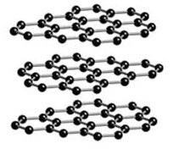
Different forms of elements and compounds
Elements and compounds can form many different structures, including:
Cl⁻
Na⁺
Cl⁻
Na⁺
Cl⁻
Na⁺
1) Ionic, like sodium chloride:
Cl⁻
Na⁺
Cl⁻
Na⁺
Cl⁻
Na⁺
2) Giant covalent structures, like graphite:
+
+
+
+
+
+
+
+
+
+
3) Metallic, like iron:
+
+
+
+
+
H
+
+
+
+
+
H
C
H
+
+
+
+
+
4) Simple covalent molecules, like methane:
H

Slide 41
Giant Ionic Structures recap
When many positive and negative ions are joined they form a “giant ionic lattice” where each ion is held to the other by strong electrostatic forces of attraction (ionic bonds).
Cl⁻
Na⁺
Cl⁻
Na⁺
Cl⁻
Na⁺
Na⁺
Cl⁻
Na⁺
Cl⁻
Na⁺
Cl⁻
Cl⁻
Na⁺
Cl⁻
Na⁺
Cl⁻
Na⁺
Na⁺
Cl⁻
Na⁺
Cl⁻
Na⁺
Cl⁻
If these ions are strongly held together what affect would this have on the substance’s:
Melting point?
Boiling point?
State (solid, liquid or gas) at room temperature?

Slide 42
Dissolving Ionic Structures
When an ionic structure like sodium chloride is dissolved it enables the water to conduct electricity as charge is carried by the ions:
Cl⁻
Na⁺
Cl⁻
Na⁺
Cl⁻
Na⁺
Cl⁻
Na⁺
Cl⁻
Na⁺
Cl⁻
Na⁺

Slide 43
A closer look at metals
Metals are defined as elements that readily lose electrons to form positive ions. The electrons in the highest shells are delocalised and surround positive ions. These delocalised electrons can be used to conduct electricity. There are a number of ways of drawing this:
+
+
+
+
+
+
+
+
+
+
+
+
+
+
+
+
+
+
+
+
+
+
+
+
+
+
+
+
-
-
+
+
+
-
+
+
-
+
+
-
+
+
+
+
+
-
+
-
-
Delocalised electrons

Slide 44
Simple Covalent Molecules
Recall our model of a simple covalent compound like hydrogen, H₂:
H
Hydrogen has a very low melting point and a very low boiling point. Why?
H
1) The intermolecular forces are very weak so each one of these H₂ molecules doesn’t really care about the others – it’s very easy to pull them apart.
2) When a substance is heated it is the intermolecular forces that are overcome, NOT the covalent bond in each molecule, which is much stronger!
Also, the molecules do not carry a charge so covalent compounds usually do not conduct electricity.

Slide 45
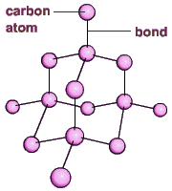
Giant Covalent structures (“lattices”)
Notice that giant covalent structures have very different properties to individual covalent molecules:
1. Diamond – a giant covalent structure with a very ____ melting point due to ______ bonds between carbon atoms
2. Graphite – carbon atoms arranged in a layered structure, with free _______ in between each layer enabling carbon to conduct _________ (like metals)
O
Si
3. Silicon dioxide (sand) – a giant covalent structure of silicon and oxygen atoms with strong _____ causing a high ______ point and it’s a good insulator as it has no free electrons
O
O
O
Si
O
Si
O
O
O
O
O
Words – melting, high, electrons, bonds, strong, electricity

Slide 46
Using Covalent Structures
Element/ compound | Property | Uses | Why?
Carbon – diamond | Very hard | Drill tips | Extremely strong covalent structure
Carbon - graphite | Soft | Lubricants | Layers “slip” off each other
Carbon - graphite | Conducts electricity | Making electrodes | Free electrons to carry charge

Slide 47
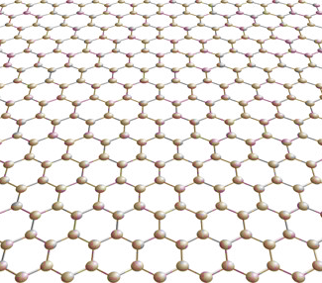
Graphene
Graphene is a single layer of carbon atoms and is only one atom thick.
Q. What are the possible uses for graphene?

Slide 48
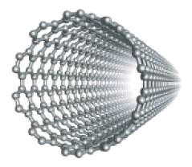
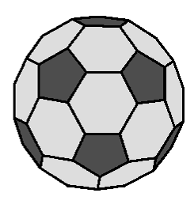
Fullerenes
Carbon can also be used to make structures called “fullerenes” (carbon atoms forming an empty shape). Fullerenes are compounds used for applications such as drug delivery, lubricants, catalysts and nanotubes and they have structures based on carbon atoms forming hexagonal rings:
“Buckminster fullerene” – the first fullerene to be discovered in 1960.
A “carbon nanotube” – high tensile strength, high electrical conductivity and high thermal conductivity

Slide 49
Polymers
02/06/2020
H
H
C
C
Polymers are compounds consisting of large molecules containing chains of carbon atoms. For example, take ethene:
H
H
Ethene
Step 1: Break the double bond
Step 2: Add the molecules together:
This molecule is called POLYETHENE – a common plastic.

Slide 50
Polymers
02/06/2020
Polymers are compounds consisting of large molecules containing chains of carbon atoms. For example:
ALKANES
Ethane
Ethene
ALKENES
Butane
Butene
This double bond means that alkenes have the potential to join with other molecules – this make them REACTIVE. Alkenes turn bromine water colourless.

Slide 51
Metals and Alloys
02/06/2020
Metals are also easy to bend and malleable. This is because the layers slide over each other:
A pure metal:
An alloy is a mixture of metals that causes the metal to behave differently:

Slide 52
Calculations involving Masses

Slide 53
Other ways of drawing covalent bonds
Consider ammonia (NH₃):
H
N
H
H
N
H
H
H
H
N
H
H
N
H
H
H
What are the limitations of each way of drawing these molecules?

Slide 54
Metals vs Non-metals
Recall that most of the elements are metals:
These elements are metals – they:
Have high melting points
Can conduct electricity
Are dense
This line divides metals from non-metals
 |  |  |  |  | H |  |  |  |  |  |  |  |  |  |  |  | He
Li | Be |  |  |  |  |  |  |  |  |  |  | B | C | N | O | F | Ne
Na | Mg |  |  |  |  |  |  |  |  |  |  | Al | Si | P | S | Cl | Ar
K | Ca |  |  |  |  |  | Fe |  | Ni | Cu | Zn |  |  |  |  | Br | Kr
 |  |  |  |  |  |  |  |  |  | Ag |  |  |  |  |  | I | Xe
 |  |  |  |  |  |  |  |  | Pt | Au | Hg
These elements are non-metals – they:
Have low melting and boiling points
Don’t conduct electricity
Are not very dense

Slide 55
Relative formula mass, M_{r}
The relative formula mass of a compound is the relative atomic masses of all the elements in the compound added together.
Relative atomic mass of O = 16
E.g. water H₂O:
Relative atomic mass of H = 1
Therefore M_{r} for water = 16 + (2x1) = 18
Work out M_{r} for the following compounds:
HCl
NaOH
MgCl₂
H₂SO₄
K₂CO₃
H=1, Cl=35 so M_{r} = 36
Na=23, O=16, H=1 so M_{r} = 40
Mg=24, Cl=35 so M_{r} = 24+(2x35) = 94
H=1, S=32, O=16 so M_{r} = (2x1)+32+(4x16) = 98
K=39, C=12, O=16 so M_{r} = (2x39)+12+(3x16) = 138

Slide 56
Empirical formulae
Empirical formulae is simply a way of showing how many atoms are in a molecule (like a chemical formula). For example, CaO, CaCO₃, H₂0 and KMnO₄ are all empirical formulae. Here’s how to work them out:
A classic exam question:
Find the simplest formula of 2.24g of iron reacting with 0.96g of oxygen.
Step 1: Divide both masses by the relative atomic mass:
For iron 2.24/56 = 0.04 For oxygen 0.96/16 = 0.06
Step 2: Write this as a ratio and simplify:
0.04:0.06 is equivalent to 2:3
Step 3: Write the formula:
2 iron atoms for 3 oxygen atoms means the formula is Fe₂O₃

Slide 57
Example questions
Find the empirical formula of magnesium oxide which contains 48g of magnesium and 32g of oxygen.
Find the empirical formula of a compound that contains 42g of nitrogen and 9g of hydrogen.
Find the empirical formula of a compound containing 20g of calcium, 6g of carbon and 24g of oxygen.
MgO
NH₃
CaCO₃

Slide 58
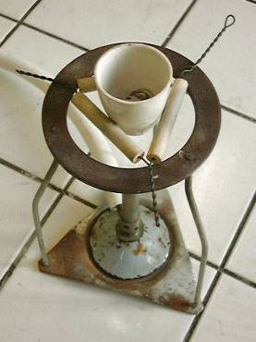
Determining Empirical Formulae
Q. How could you use this experiment to deduce the empirical formula of magnesium oxide?

Slide 59
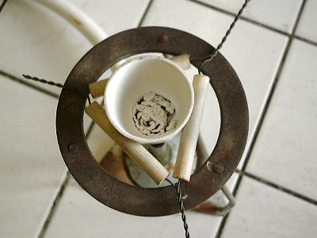
An example of Conservation of Mass
Here’s a classic experiment where magnesium is burned in a crucible:
2Mg + O₂ 2MgO
Mass of magnesium and crucible after burning = 78.56g
Mass of magnesium and crucible before burning = 78.25g
Mass is always conserved in any reaction, so where did this extra mass come from?

Slide 60
Example Questions
For each of the following reactions, state whether or not the mass of the total system should go up or down and explain your answer:
Iron + oxygen iron oxide
Copper carbonate copper oxide + carbon dioxide
For higher tier, write a balanced equation for each reaction, given that iron oxide is Fe₂O₃ and copper carbonate is CaCO₃.

Slide 61
Calculating the mass of a product
E.g. what mass of magnesium oxide is produced when 60g of magnesium is burned in air?
IGNORE the oxygen in step 2 – the question doesn’t ask for it
Step 1: READ the equation:
2Mg + O₂ 2MgO
Step 2: WORK OUT the relative formula masses (M_{r}):
2Mg = 2 x 24 = 48 2MgO = 2 x (24+16) = 80
Step 3: LEARN and APPLY the following 3 points:
48g of Mg makes 80g of MgO
1g of Mg makes 80/48 = 1.66g of MgO
60g of Mg makes 1.66 x 60 = 100g of MgO

Slide 62
When water is electrolysed it breaks down into hydrogen and oxygen:
2H₂O 2H₂ + O₂
What mass of hydrogen is produced by the electrolysis of 6g of water?
Work out M_{r}: 2H₂O = 2 x ((2x1)+16) = 36 2H₂ = 2x2 = 4
36g of water produces 4g of hydrogen
So 1g of water produces 4/36 = 0.11g of hydrogen
6g of water will produce (4/36) x 6 = 0.66g of hydrogen
2) What mass of calcium oxide is produced when 10g of calcium burns?
2Ca + O₂ 2CaO
M_{r}: 2Ca = 2x40 = 80 2CaO = 2 x (40+16) = 112
80g produces 112g so 10g produces (112/80) x 10 = 14g of CaO
3) What mass of aluminium is produced from 100g of aluminium oxide?
2Al₂O₃ 4Al + 3O₂
M_{r}: 2Al₂O₃ = 2x((2x27)+(3x16)) = 204 4Al = 4x27 = 108
204g produces 108g so 100g produces (108/204) x 100 = 52.9g of Al₂O₃

Slide 63
A note about volume…
The two most commonly used units of volume in chemistry are the cm³ and the dm³:
1cm³
1dm³ (= 1000cm³)
Convert 1250cm³ into dm³
Convert 1cm³ into dm³
Convert 0.056dm³ into cm³
Convert 1.28dm³ into cm³

Slide 64
A “Mole” in numbers (higher only)
Definition:
A mole of a substance is the relative formula mass of that substance in grams,
For example, 12g of carbon would be 1 mole of carbon...
...and 44g of carbon dioxide (CO₂) would be 1 mole etc...
Q. How many moles are the following?
23g of sodium
48g of magnesium
36g of carbon
28g of iron
1 mol
2 mol
3 mol
0.5 mol

Slide 65
A “Mole” (higher only)
Definition:
A mole of a substance ALWAYS contains the same number of molecules/ions/particles/atoms:
Avogadro’s Constant: 1 mole = 6.02x10²³ molecules
Q. How many moles are the following?
How many molecules are in 2 moles of carbon?
What about 2 moles of magnesium?
How many molecules are in 46g of sodium?
How many molecules are in 23g of iron?
1.2x10²⁴
1.2x10²⁴
1.2x10²⁴
3.0x10²³

Slide 66
Molar Calculations (higher only)
No. of moles =
Mass (g)
m
N =
Molar mass (g/mol)
M
Some example questions:
Calculate the mass of 4 mol of lithium
Calculate the mass of 2 mol of sodium
Calculate the number of moles in 36g of carbon
Calculate the number of moles in 88g of carbon dioxide
Calculate the number of moles in 27g of water
28g
46g
3 mol
2 mol
1.5 mol

Slide 67
Harder Molar Calculations (HT only)
Mass (g)
m
1 mole = 6.02x10²³ molecules
No. of moles =
N =
Molar mass (g/mol)
M
Some example questions:
How many moles and how many molecules would be in 46g of sodium?
How many grams would 1.806x10²⁴ molecules of carbon weigh?
How many grams would 1 millions molecules of hydrogen weigh?
2 moles, 1.2x10²⁴ molecules
36g
1.66x10-¹⁸g

Slide 68
Concentration
Concentration means “how much of a chemical there is in a fixed volume” and can be measured in g/dm³ or mol/dm³.
A solution of low concentration (“dilute”)
A solution of high concentration (“strong”)

Slide 69
Questions on Concentration
To calculate the concentration of a substance you could use this formula:
Conc. = Mass of substance (g)
Volume of solvent (dm³)
Calculate, with units, the concentration of the following:
A solution of 10g salt in 1dm³ of water
2g of hydrochloric acid in 500cm³ of water
10kg of salt in 200dm³ of water
0.5g of sodium hydroxide in 100cm³ of water

Slide 70
Calculating the mass of a product using moles (higher only)
Let’s try this question again but using moles:
Step 1: READ the equation:
2Mg + O₂ 2MgO
“2 moles of magnesium + 1 mole of oxygen forms 2 moles of magnesium oxide”
Step 2: WORK OUT the relative formula masses (M_{r}) of MgO:
2MgO = 2 x (24+16) = 80
Step 3: Apply these steps:
60g of Mg is equal to 1.25 moles (60/48)
Therefore we will make 1.25 moles of magnesium oxide
Therefore we make 100g of MgO (1.25 moles)

Slide 71
Limiting Reactants (higher only)
What happens if you use too much of one compound? Example question:
Consider the reaction you have when you burn methane:
CH₄ + 2O₂ CO₂ + 2H₂O
A student burns 32g of methane in 72g of oxygen. Which reactant is used up completely?
32g of methane is 2 moles. 72g of oxygen is 2.25 moles of O₂. Therefore this reaction is limited by the 2 moles of methane – the “limiting reactant” (i.e. the reactant that is not in excess).
2 moles (88g)
Q. How much CO₂ would we expect to produce?

Slide 72
Using Moles to balance equations higher only)
Example question:
130g of zinc reacts with 146g of hydrochloric acid (HCl) to form 272g of zinc chloride (ZnCl₂) and some hydrogen (H₂). Answer the following:
How much hydrogen was produced?
How many moles of each substance were reacted/produced?
Write a balanced chemical equation for this reaction.
4g
1 of Zn, 2 of HCl, 1 of ZnCl₂, 1 of H₂
Zn + 2HCl ZnCl₂ + H₂

